Slide 1
Barriers for circular business models in the textile sector
Minna Salo, VTT Technical Research Centre of Finland
Co-author: Päivi Petänen, VTT

Slide 2
tExtended - Knowledge based Framework for Extended Textile Circularity -project
Funding from Horizon Europe Programme (HORIZON-CL4-2022-TWIN-TRANSITION-01-10)
Coordinator: VTT Technical Research Centre of Finland Ltd.
20 partners from 10 countries
Duration: 4 years, started 1st Dec 2022
Linkages to European level activities and initiatives e.g.
  Processes4Planet Partnership
  Hubs4Circularity & Industrial-Urban Symbiosis
  ECOSYSTEX & ECoP - European Community of Practice
2

Slide 3
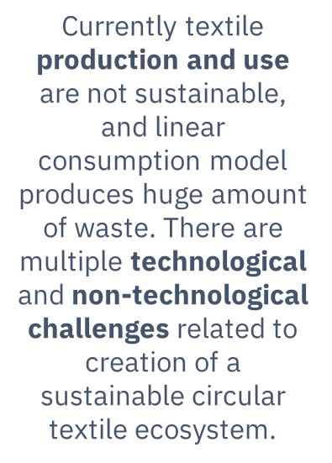
Background and purpose of the study
  Investigate the current state of and future pathways towards circular business models among different textile sector companies
  Identify what types of factors are currently seen as barriers for circularity among the textile sector companies
  Provide practical implications for the textile sector companies to have a common understanding on what things are currently seen as barriers for circularity of the current business models within textile sector in Europe.
    Based on the framework, the textile sector companies can together start to think about ways to overcome the barriers in the future.
3

Slide 4
Approach
Qualitative case study
The main research question: “What are the barriers for circularity of the business models of the different textile sector companies?”
Data from interviews with representatives from eight companies
4

Slide 5

Results: Barriers for circular business models in the textile sector
  Barriers for circular business models in textile sector are manifold
  The previous studies have grouped the barriers based on the level of an individual organization, value chain, customer and market
    The barriers our interviewees had identified, belonged to multiple categories
  Based on our results, the barriers of circular business models in the textile sector can be divided into six barrier types:
    Economic barriers
    Technological barriers
    Legislative barriers
    Customer related barriers
    Resource and capacity related barriers
    Cultural barriers

Slide 6
Results: Economic barriers
Developing novel circular solutions is costly, however, the customers are not willing to pay more for them
Circular materials cost more than virgin materials, more financial planning is needed
Economic barriers
“The transition towards circularity requires a lot more financial planning and resources from the textile sector companies”

Slide 7
Results: Technological barriers
Technological barriers
Lack of reliable technologies to enable circular production, sorting post-consumer waste, and recycling
Lack of knowledge and skills within the textile sector companies in utilizing relevant technologies
“There are technological barriers within an organization (lack of technological know-how) and in the market-level (lack of reliable technologies in the market)”

Slide 8
Results: Legislative barriers
Legislative barriers
Legislation, especially Extended producer responsibility is challenging the transition towards circular business
Adapting to new circularity-related legislations requires time and resources from the textile sector companies
Policies and laws prohibit collecting external waste for textile production
Policies and legislation do not support the alignment of value chain actors related to circularity and sustainability
Policies and laws outside of Europe give non-European textile actors a competitive advantage
Unclarity of legislation in Europe increases the amount of administrative tasks in the textile sector companies
“There is unclarity in the legislation both between European and non-European countries and within Europe.”

Slide 9
Results: Customer related barriers
Customer related barriers
Product collection and recycling from consumers cannot be fully controlled or monitored
There is no market push, there is a need to make the consumers to demand and to buy textiles made from recycled materials to make thew transition towards circularity happen in the textile industry
Low awareness and knowledge of the circular products among customers: e.g. circular products are perceived as lower quality than linear products
“Customers are not truly aware of the quality and benefits of the circular products.”

Slide 10
Results: Resource and capacity related barriers
Resource and capacity related barriers
The supply chain does not have the necessary applications, attitude or resources for circularity
Current capacity and resources are not enough to sort recycled textile products and materials from consumers if the amount of recycled materials increases in the future
The capacity for sustainable textile raw materials is limited
“The transition towards circularity requires a lot more resources and (new) competencies from the textile sector companies.”

Slide 11
Results: Cultural barriers
It is more complex to be circular than linear and that´s why the resistance is high among the personnel in the textile manufacturing companies
Mindset change is slow, in the textile industry as a whole and internally in textile sector companies
Cultural barriers
“Change towards circular business needs willingness and change in the mindset of the personnel.”

Slide 12

Limitations of the study
The barriers for circular business models in the textile sector were not prioritized during our study
  We didn´t ask the interviewees to make a value judgement on the barriers. We simply asked the interviewees to tell us all the things that they are currently seen as barriers
Our results remain limited to the perceptions of eight textile sector companies that are interested in circular business models
  Future studies could place more emphasis on selecting companies that are not so eager to turn their business more circular

Slide 14

Thank you!
Minna Salo
Senior Scientist
Sustainable Business
+358 40 480 3420​
minna.salo@vtt.fi

