Slide 1
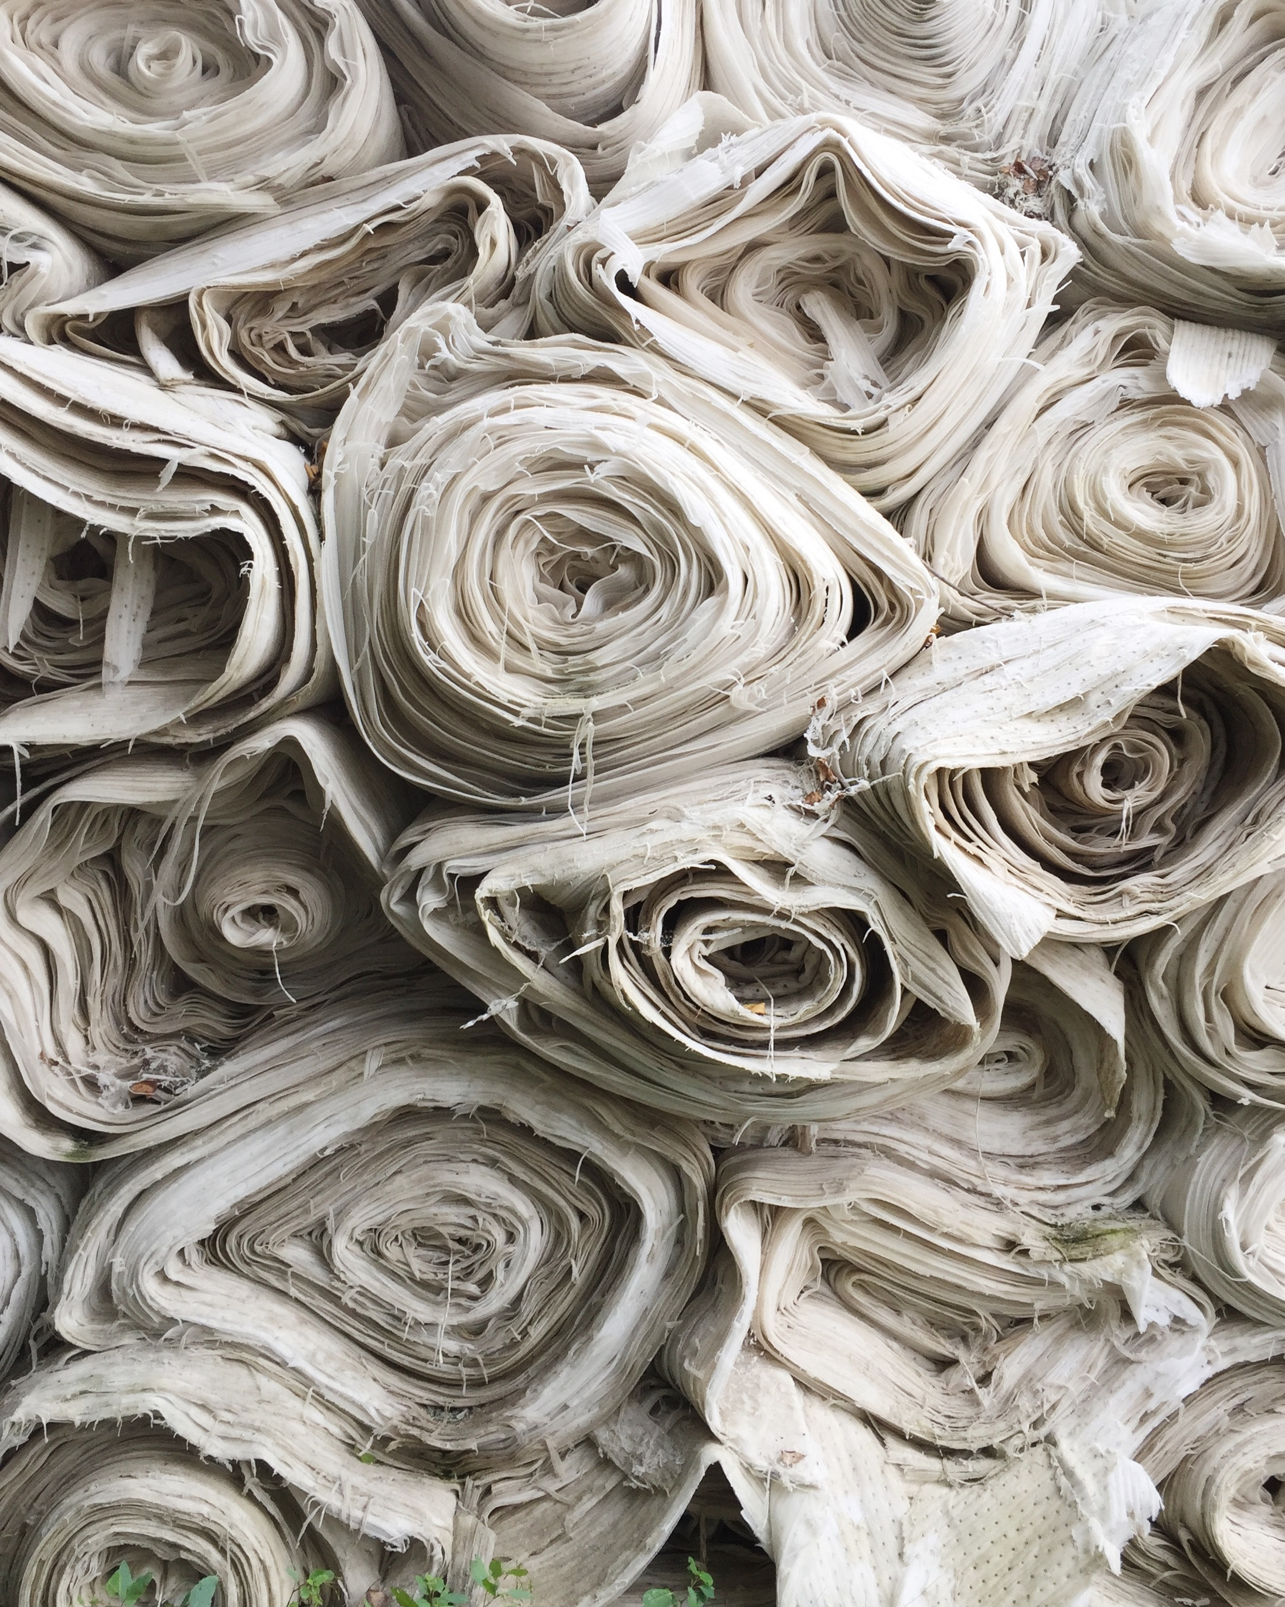
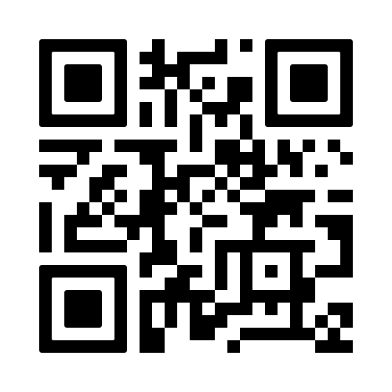
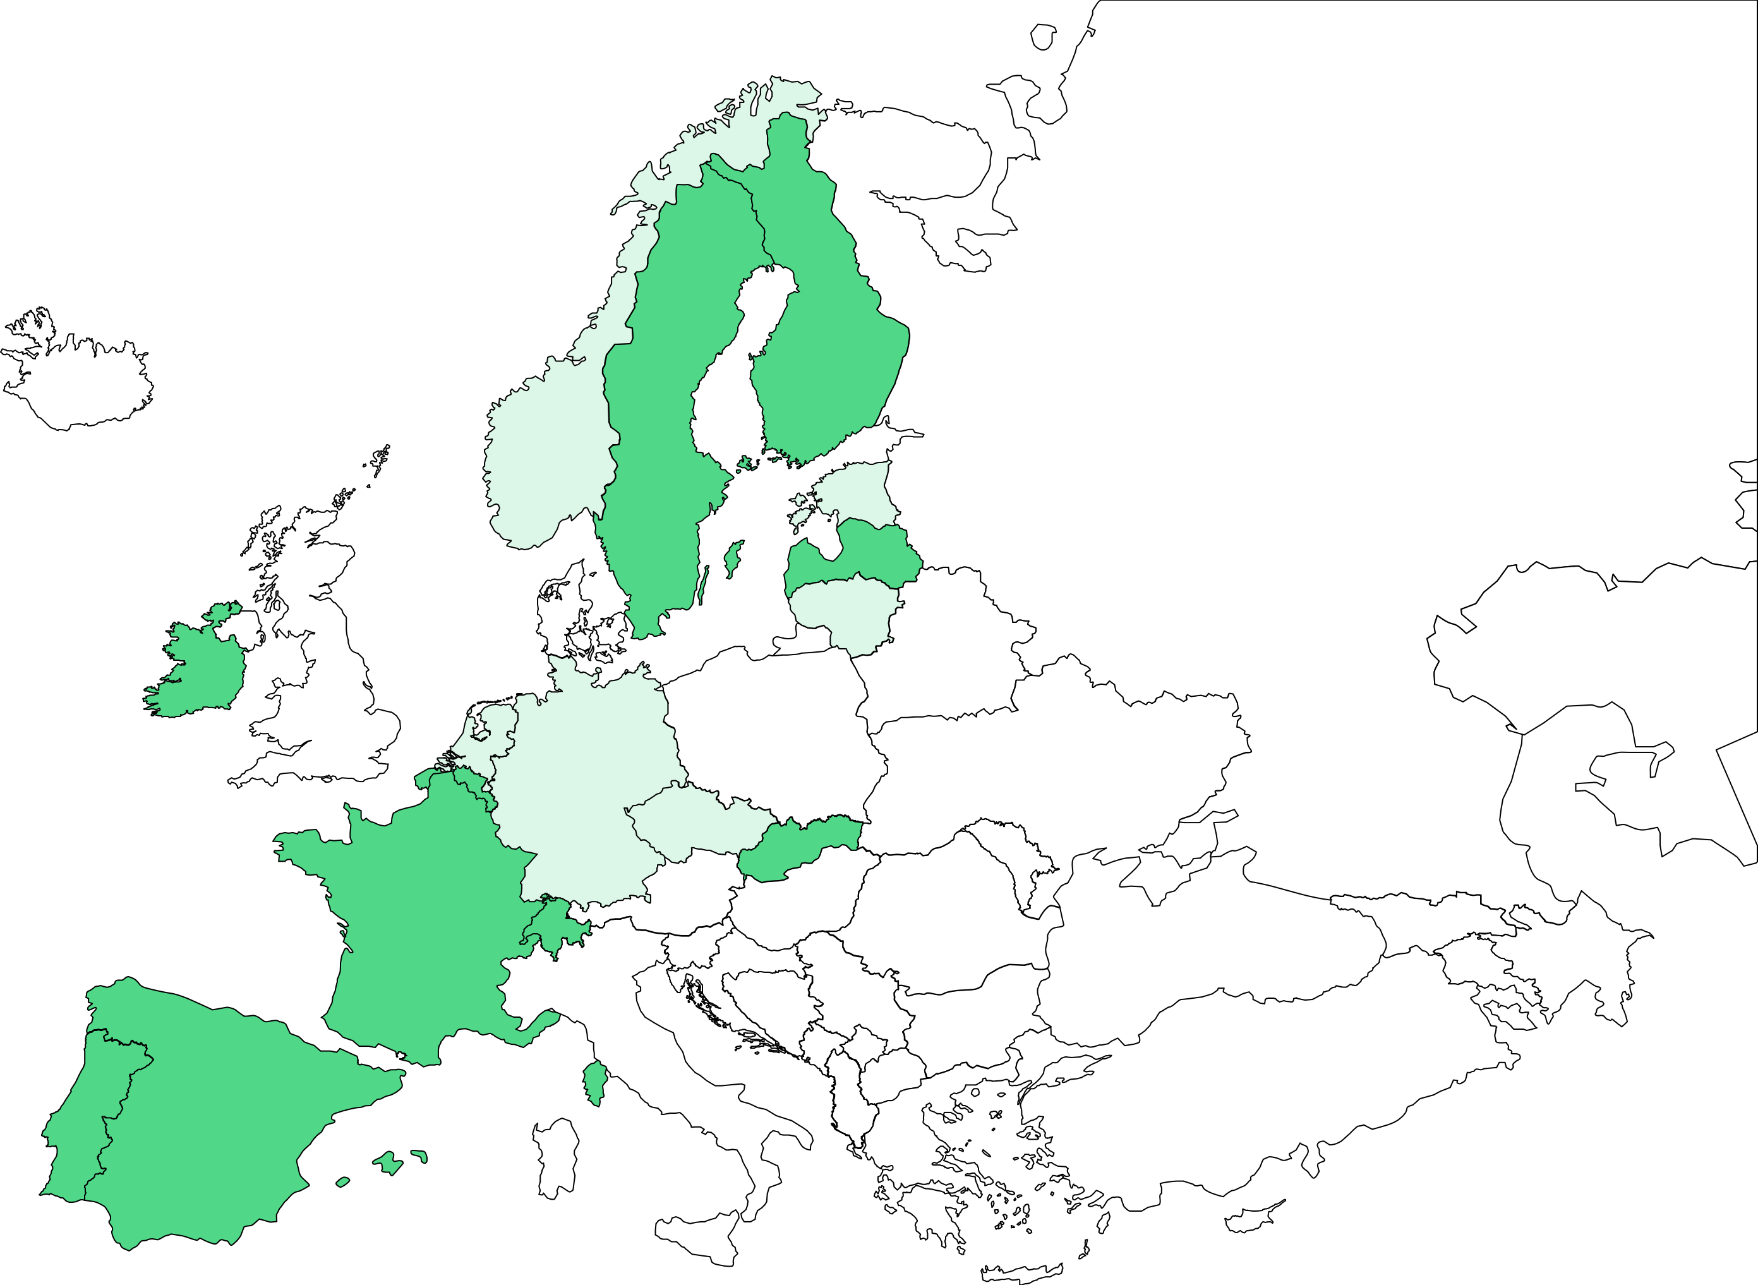
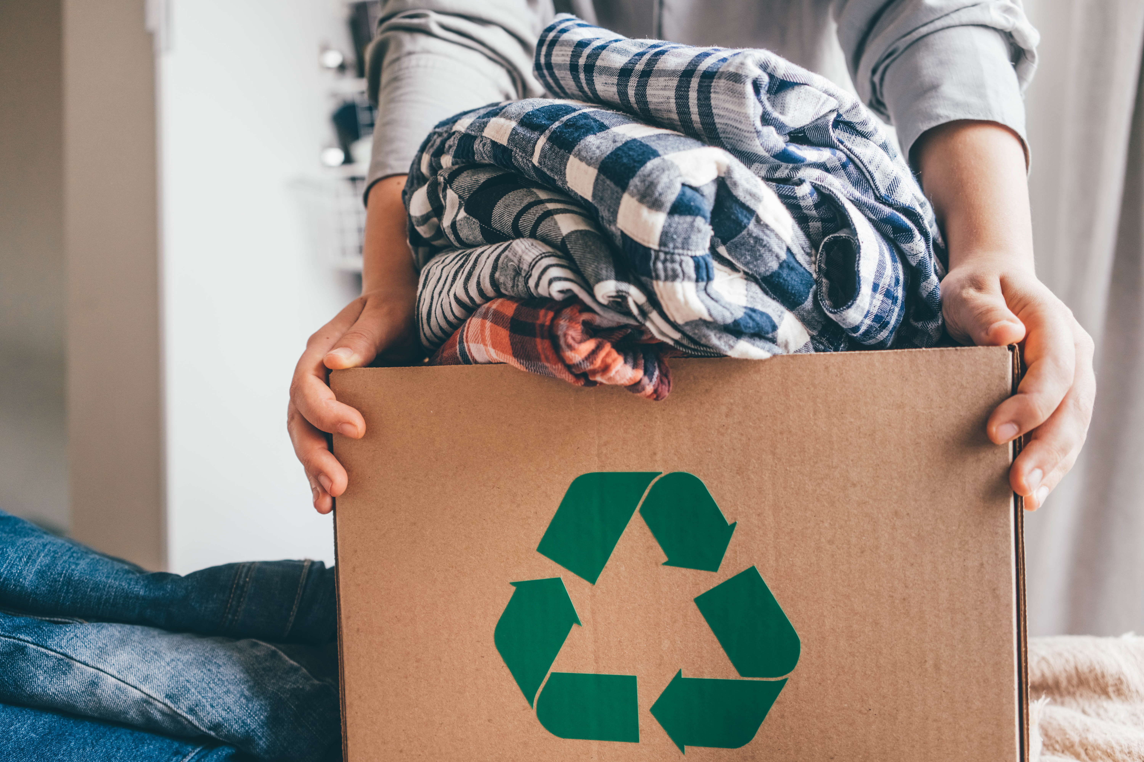
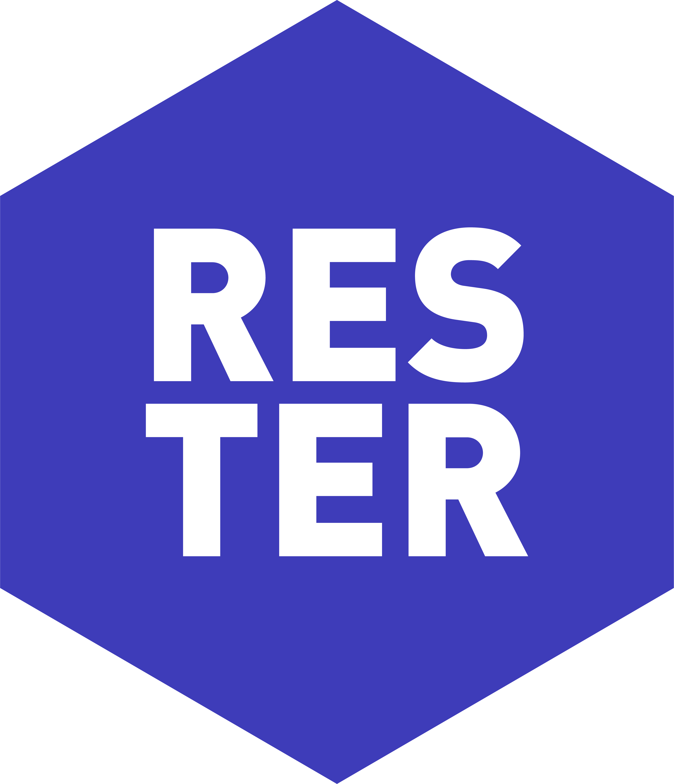
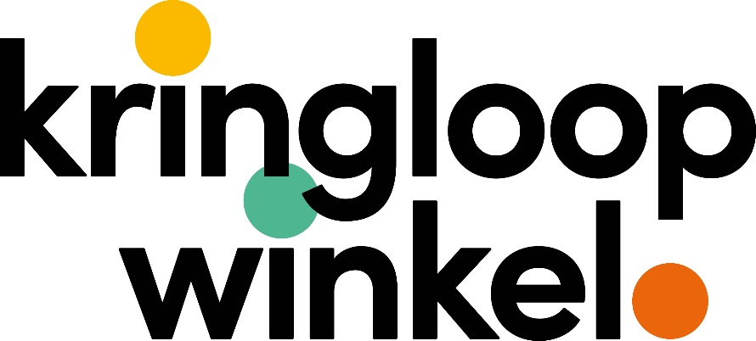
Knowledge Based Framework for Extended Textile Circulation
Funded by the European Union. Views and opinions expressed are however those of the
author(s) only and do not necessarily reflect those of the European Union or HaDEA.
Neither the European Union nor the granting authority can be held responsible for them.
www.textended.eu
INTRODUCTION
@tExtendedEU
Separate collection of textile waste will be started by EU member states by 2025. Currently the textile sorting is done mainly by hand, which isn’t accurate enough for high-value end uses: technologies and know-how are needed for the identification, collection, and automated sorting as well as for the recycling of the collected and sorted waste.
Even though most textile materials are made of blended fibres, the current technologies lack the necessary processing options.
The current activities mainly focus on down-cycling the waste to low value applications, and the current textile fibres aren’t sustainable: they are oil-based, and the cultivation of the cotton needed to produce them require lots of water and chemicals.
To support an efficient material flow, circular economy processes and the Industrial-Urban Symbiosis, also data sharing readiness needs to be increased. The circular textile system also needs the contribution of textile users, who need to be motivated to participate.
EXPECTED RESULTS
The overall objective of the tExtended project is to develop a knowledge-based Blueprint, i.e., a masterplan for a sustainable textile ecosystem.
The basis of the Blueprint is a Conceptual Framework determining the optimized utilization of textile flows, aiming for retention of value of materials in a safe and sustainable way.
Based on the Blueprint, we will implement a Real Scale Demonstrator, verifying its replicability and potential to reduce textile waste by 80%.
EXPECTED OUTCOMES AND TARGET GROUPS
Pathways
1 – Knowledge based and digitally enabled circular textile ecosystem
2 – Efficient textile recovery
3 – Waste valorisation and recycling
4 – Systemic, sustainable and safe circularity for textiles
Target groups
1 – Waste management actors
2 – Recyclers
3 – Textile Producers & Brands
4 – Automatization & machine building & process development experts
IMPACT
Scientific: Production of new fundamental and applied knowledge for industries and scientific communities, produced on circular economy of textiles.
Economic/Technological: Acceleration of the twin green and digital transition in European textile industry by generating new business, strengthening competitiveness and resilience through sustainability, and digitalization.
Societal: Prevention of waste, sustainable consumption models via re-use, creation of jobs.
APPROACH
Circular textile ecosystem:
Provides an overview on value chains, shared data and symbiotic interactions in future circular textile ecosystem. Social Innovation Spin-Off.
Digital tools and technologies for textile recovery:
Develops data-driven solutions for optimisation of textile recovery (data sharing, identification, sorting, and development of pre-processing for valorisation).
Textile recycling technologies:
Develops textile recycling processes (mechanical, thermo-mechanical and chemical processes); and adjusts textile manufacturing to extended use of secondary raw materials.
Data-driven framework for textile circulation:
Builds a textile classification system, collects textile life-time data and develops the Conceptual Framework for determination of an optimised – safe and sustainable – utilization route for different types of textile flows.
Demonstrators:
Introduces the Blueprint – implementation plan for the Conceptual Framework; A real scale demonstrator by joined resources of the tExtended consortium; Replication potential study in different regions.
Benefits to sustainability and circularity:
Evaluates sustainability, circularity potential and technological and non-technological barriers.
PROJECT PARTNERS

