Slide 1
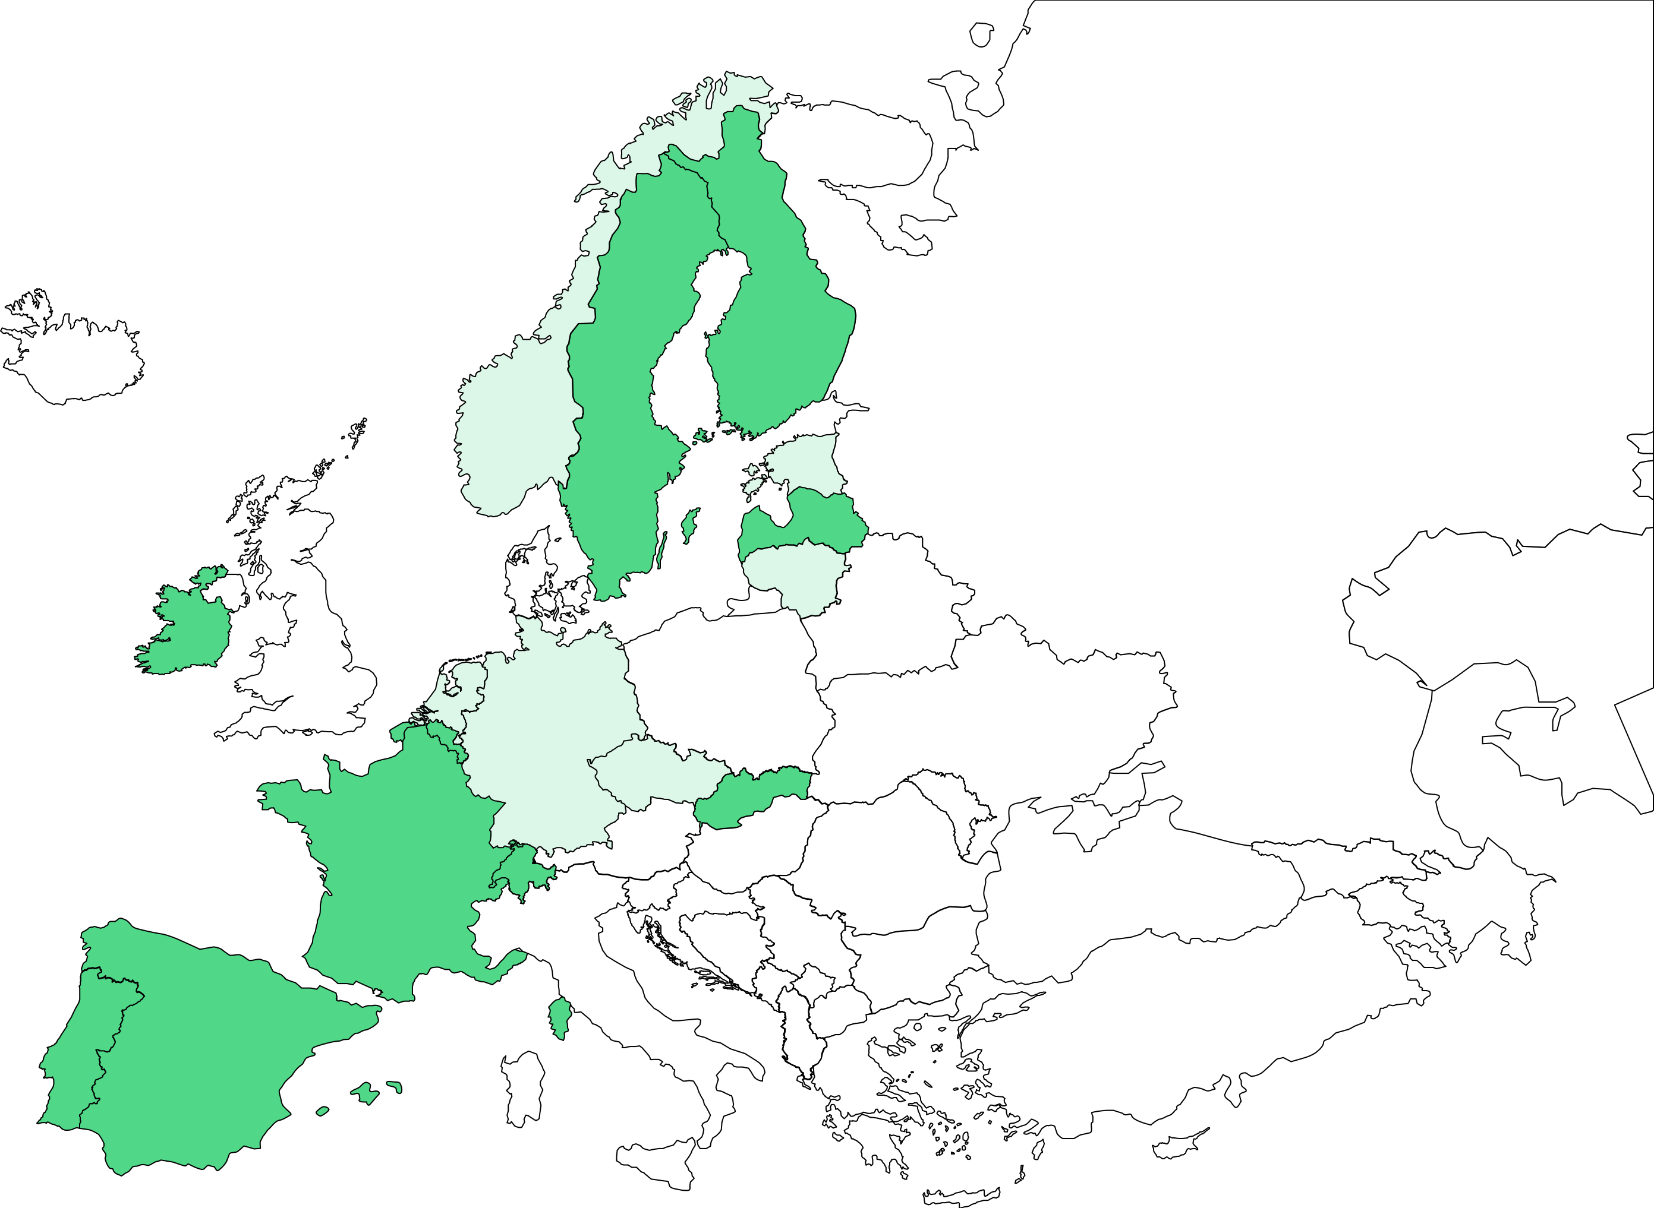
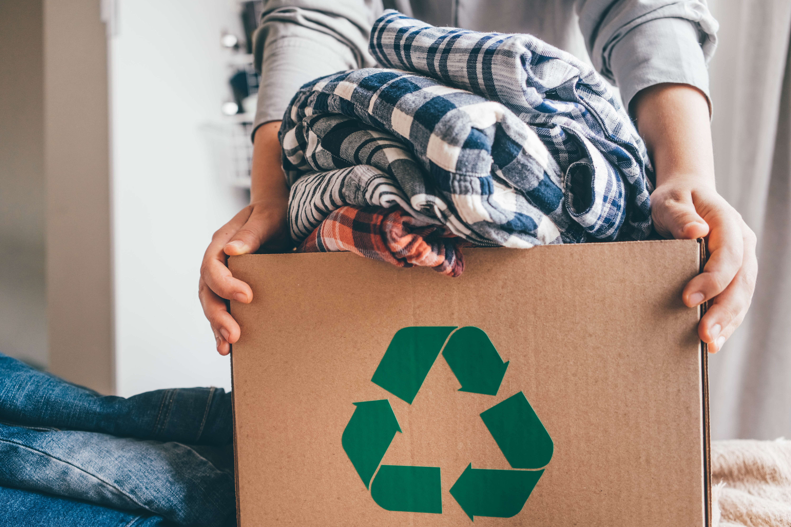
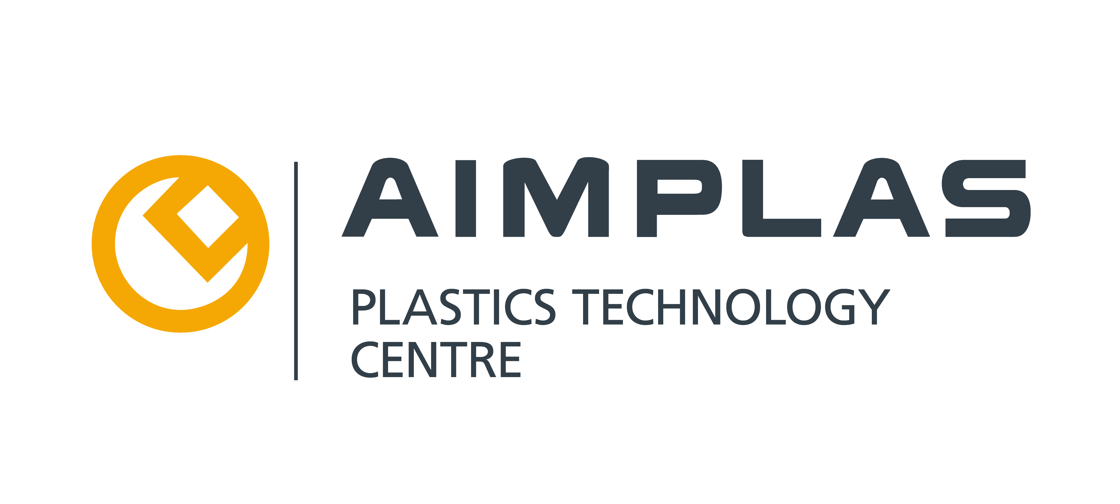
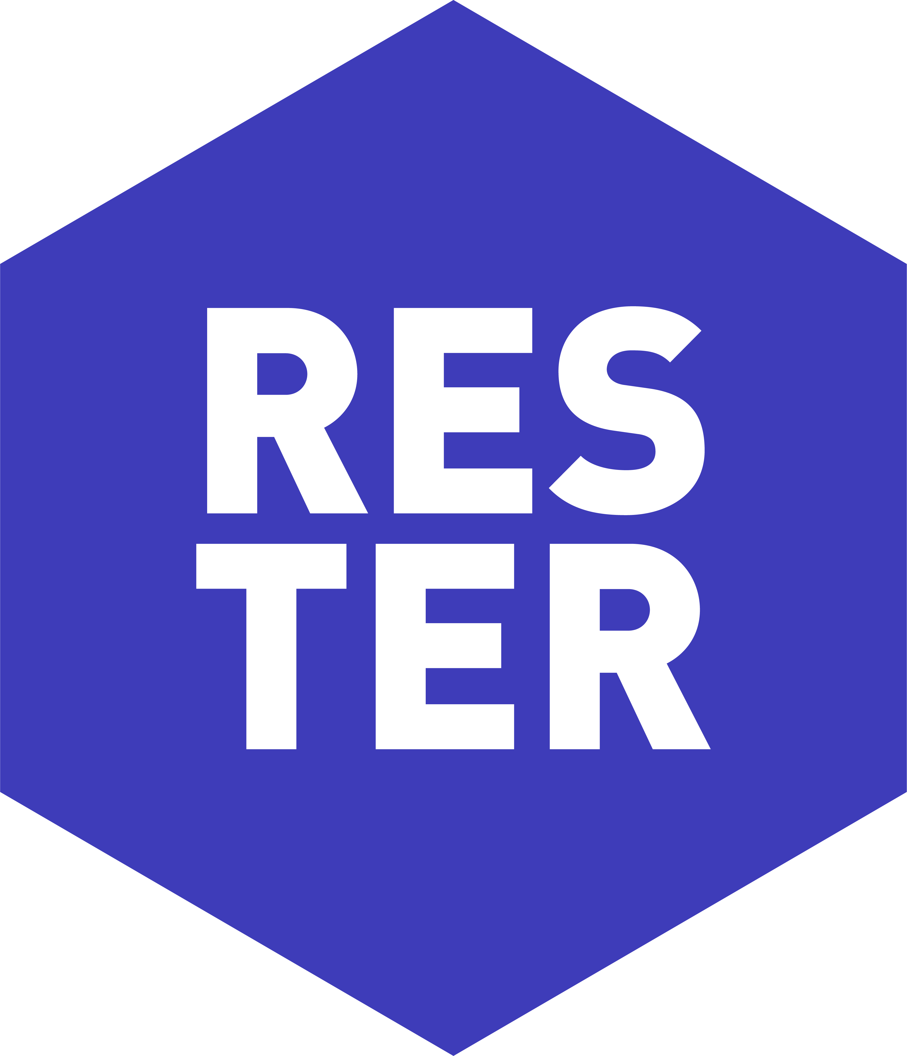
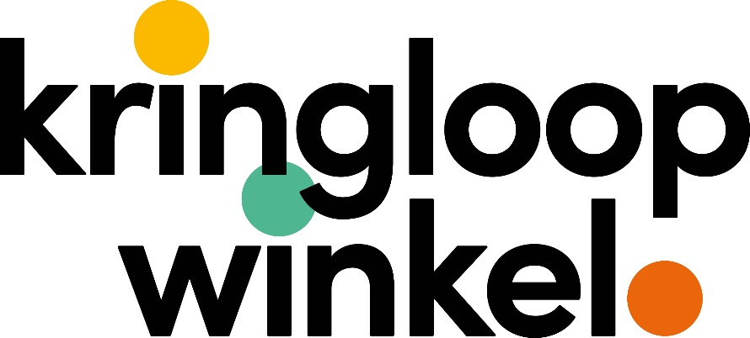
Knowledge Based Framework for Extended Textile Circulation
Funded by the European Union. Views and opinions expressed are however those of the
author(s) only and do not necessarily reflect those of the European Union or HaDEA.
Neither the European Union nor the granting authority can be held responsible for them.
www.textended.eu
THE PROJECT
@tExtended
The overall objective of the tExtended project is to develop a knowledge-based Blueprint, i.e., a masterplan for a sustainable textile ecosystem.
The basis of the Blueprint is a Conceptual Framework determining the optimized utilization of textile flows, aiming for retention of value of materials in a safe and sustainable way.
Based on the Blueprint, we will implement a Real Scale Demonstrator, verifying its replicability and potential to reduce textile waste by 80%.
THE BLUEPRINT
Textile use
Extended use phase via high quality
Expected outcomes
1 – Knowledge based and digitally enabled circular textile ecosystem
2 – Efficient textile recovery
3 – Waste valorisation and recycling
4 – Systemic, sustainable and safe circularity for textiles
Reduction of production waste
Textile collecting
Target groups
1 – Re-use and waste management actors
2 – Recyclers
3 – Textile producers & brands
4 – Automatization & machine building & process development experts
Production of textile…
…products
Reuse of products via second-hand shops, charities…​
Recovery of textiles
…materials - yarns and fabrics
Reuse of textile materials via remanufacturing​
Cycles for discarded textiles
Identification and sorting​
…fibres
Theoretical basis for optimal cycling of textiles:
Pre-processing and waste valorisation​
Recycling of fibres mechanical recycling​
Conceptual Framework based on knowledge and data regarding:
Identified composition, quality & classification affecting possible re-utilization
Environmental and social impacts of different options
Economical aspects
Application specific requirements for secondary raw materials
Recycling and valorisation of fibre raw materials​ including thermo-mechanical and various chemical recycling methods
Recycling
THE IMPACT
Scientific: Production of new fundamental and applied knowledge for industries and scientific communities, produced on circular economy of textiles.
Economic/Technological: Acceleration of the twin green and digital transition in European textile industry by generating new business, strengthening competitiveness and resilience through sustainability, and digitalization.
Societal: Prevention of waste, sustainable consumption models via re-use, creation of jobs.
Environmental: More sustainable textile industry, less emissions, potential to reduce textile waste by 80%.
THE APPROACH
Circular textile ecosystem:
Provides an overview on value chains, shared data and symbiotic interactions in future circular textile ecosystem. Social Innovation Spin-Off.
Digital tools and technologies for textile recovery:
Develops data-driven solutions for optimisation of textile recovery (data sharing, identification, sorting, and development of pre-processing for valorisation).
Textile recycling technologies:
Develops textile recycling processes (mechanical, thermo-mechanical and chemical processes); and adjusts textile manufacturing to extended use of secondary raw materials.
Data-driven framework for textile circulation:
Builds a textile classification system, collects textile life-time data and develops the Conceptual Framework for determination of an optimised – safe and sustainable – utilization route for different types of textile flows.
Demonstrators:
Introduces the Blueprint – implementation plan for the Conceptual Framework; A real scale demonstrator by joined resources of the tExtended consortium; Replication potential study in different regions.
Benefits to sustainability and circularity:
Evaluates sustainability, circularity potential and technological and non-technological barriers.
PROJECT PARTNERS

